Slide 1

Stage 7
Ammo Delivery
Course Designer: Ken Wang
Ammo Delivery is an 18 round, 90 point Comstock medium course. There are 9 USPSA targets. The best two hits per target will score. The start signal is audible.
The Handgun start position is feet touching start stick with wrists below belt. Handgun is loaded and holstered.
The PCC start position is feet touching start stick with PCC loaded, safety on, stock on belt.
On the audible start signal, engage all targets from within the shooting area.
Ammo can starts on top of the barrel and must be used to activate the stomp pad.
Stomp pad activates swinger 1 & 2. Both remain visible at rest.
Notes:
‹#›

Slide 2
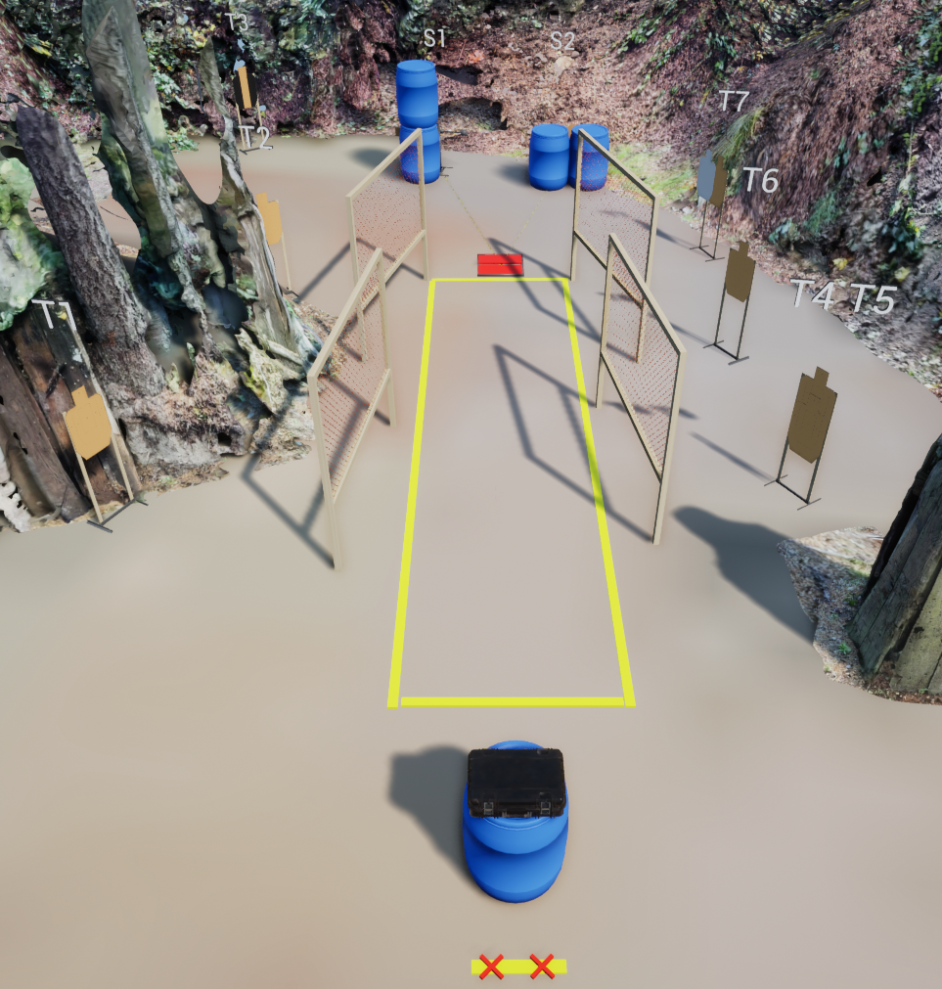
Stage 7
Ammo Delivery
Course Designer: Ken Wang

